Slide 1
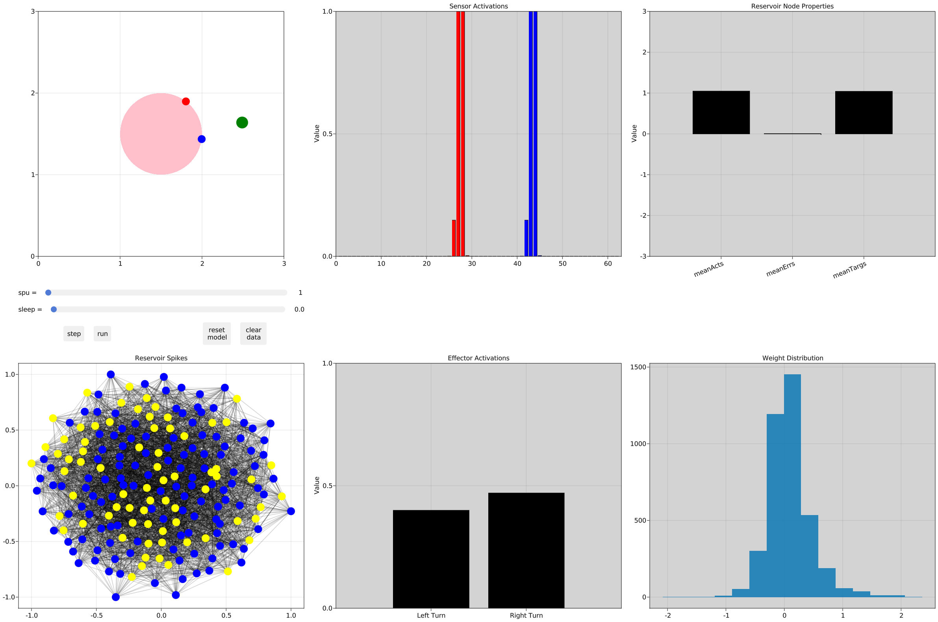
Agent & Stimulus
Sensor Activations
Reservoir Node Properties
Mean
Activations
Mean
Errors
Mean
Targets
Reservoir Spikes
Effector Activations
Reservoir Weights Distribution

Slide 2
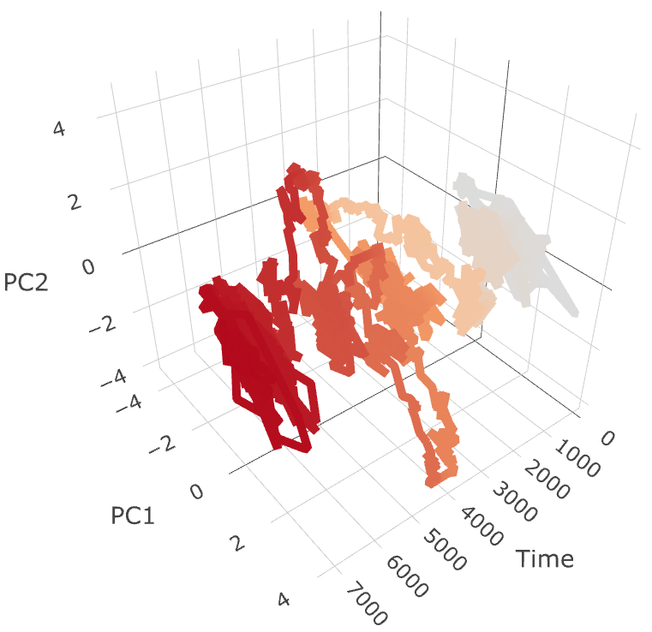
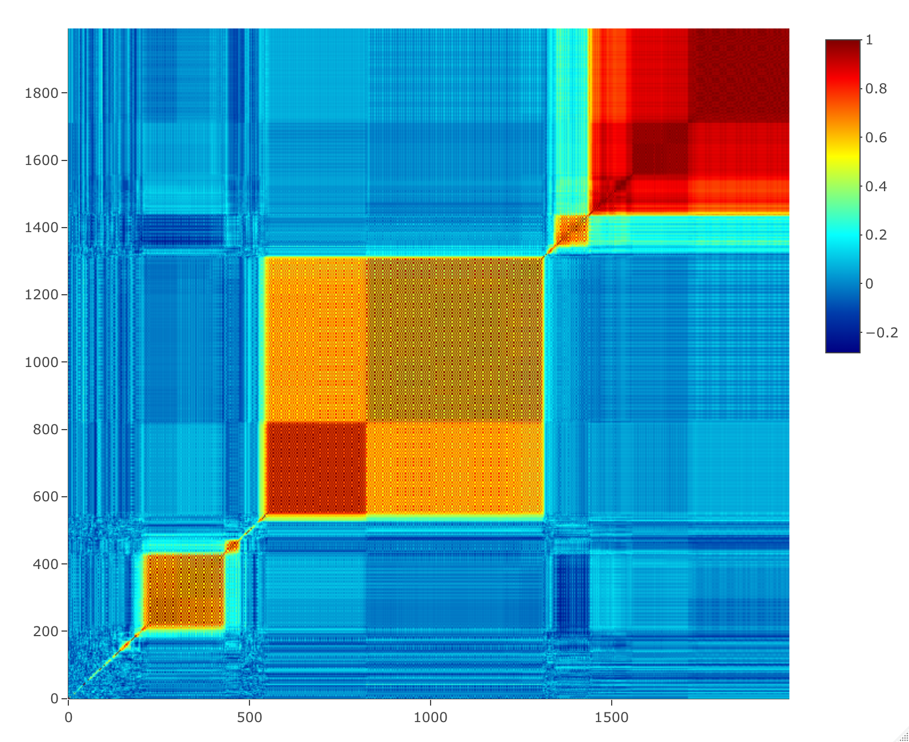
A.
C.
B.

Slide 3
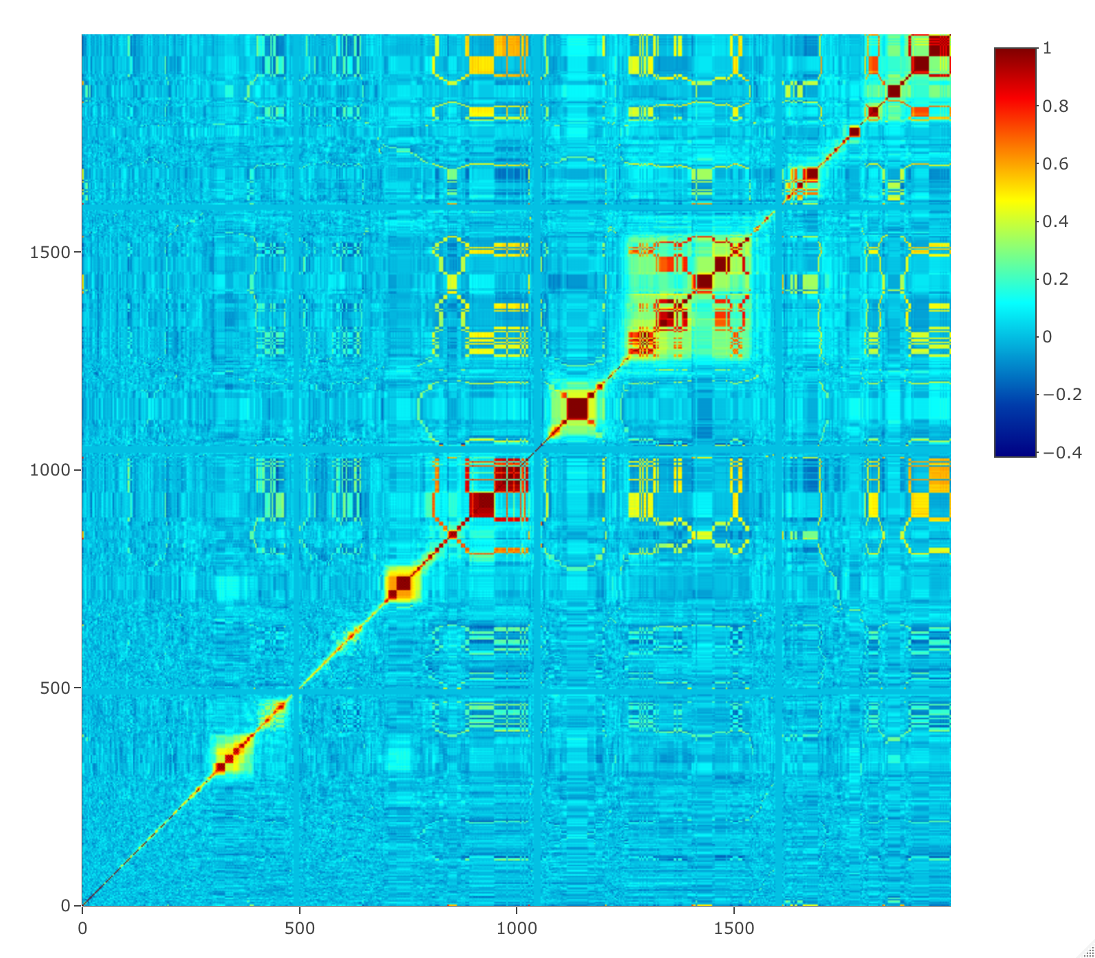
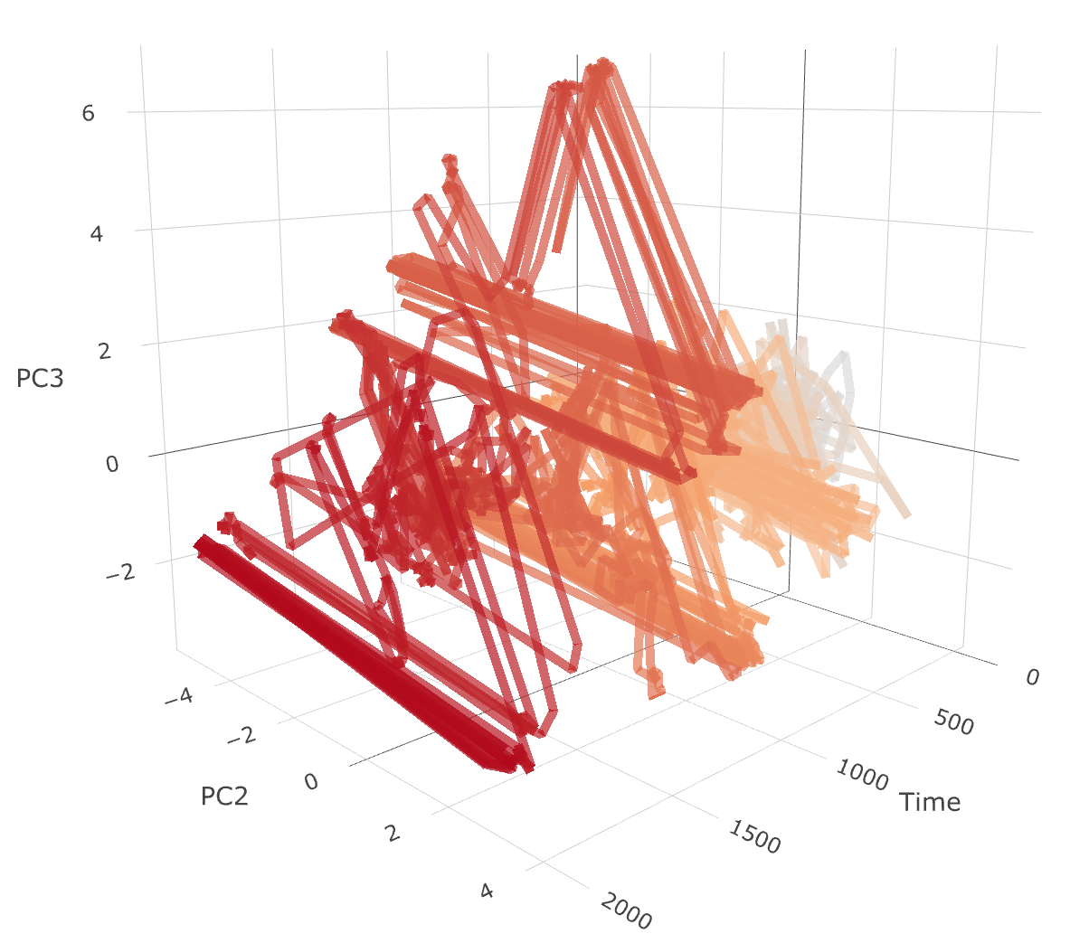
A.
B.
C.

Slide 4
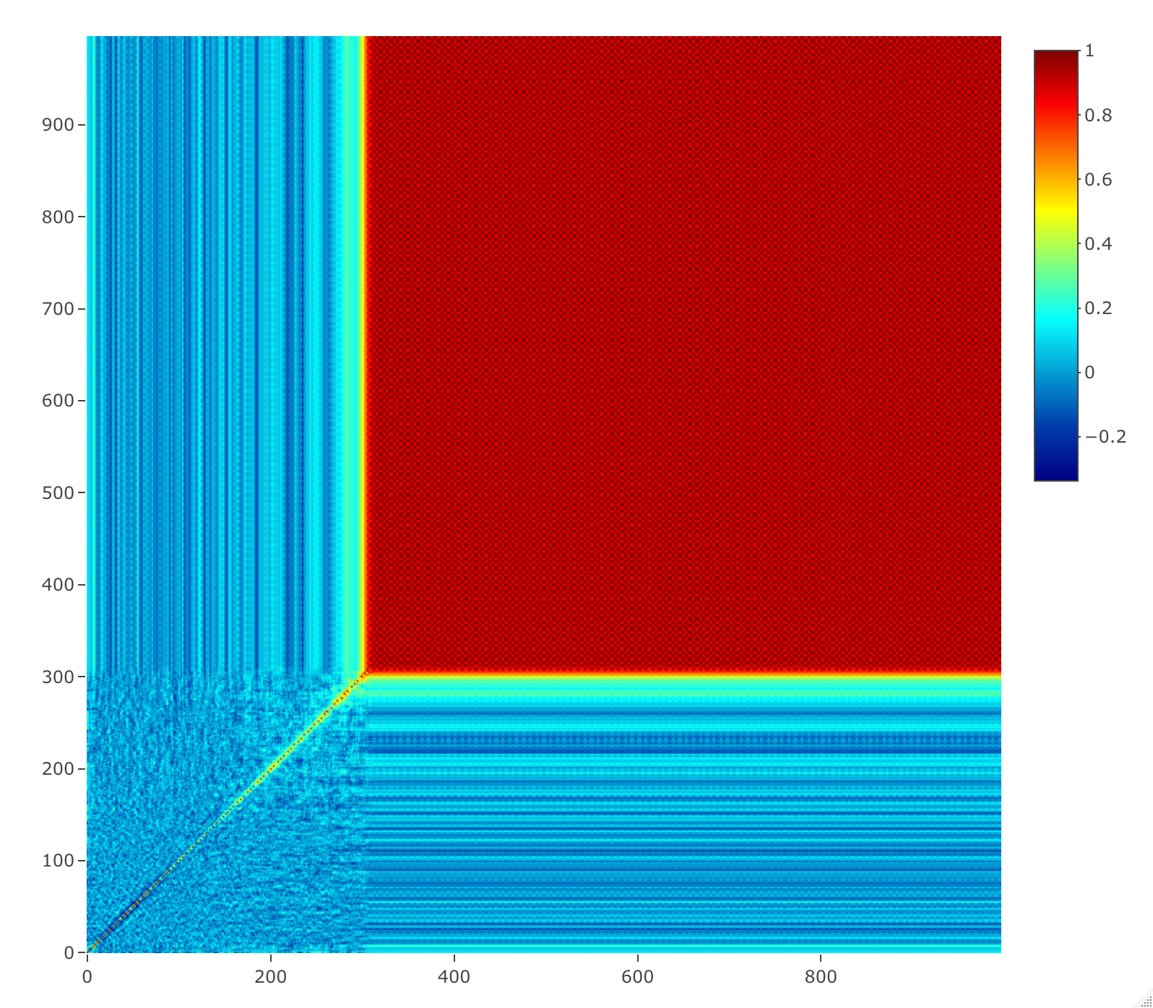

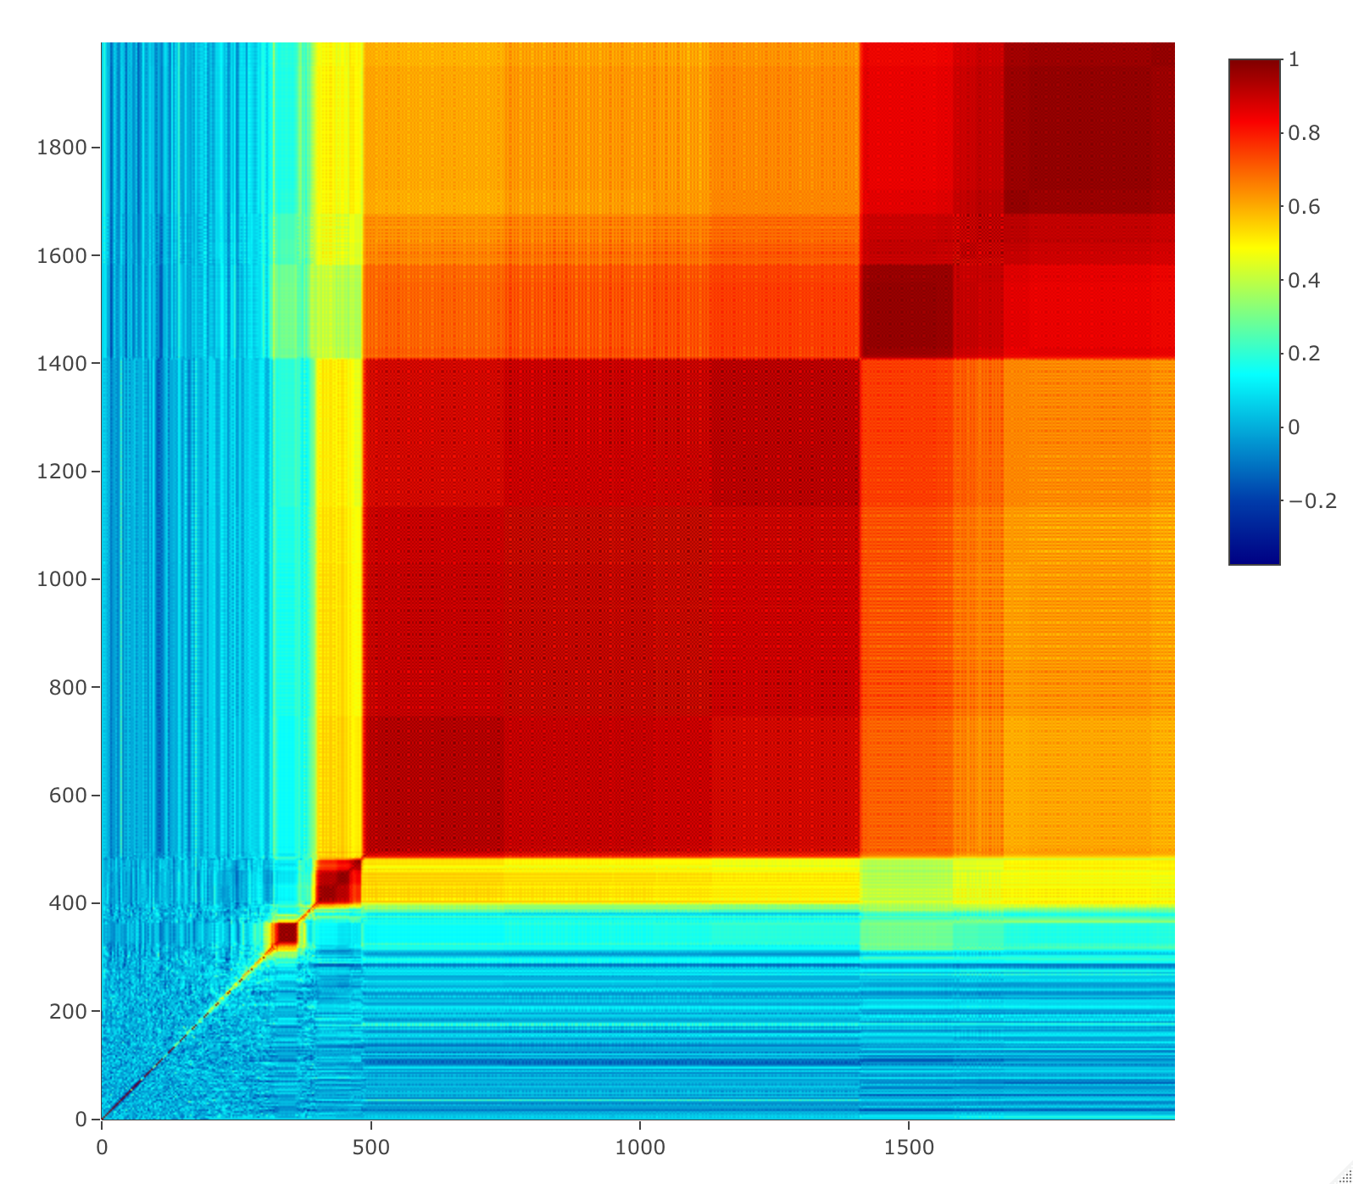
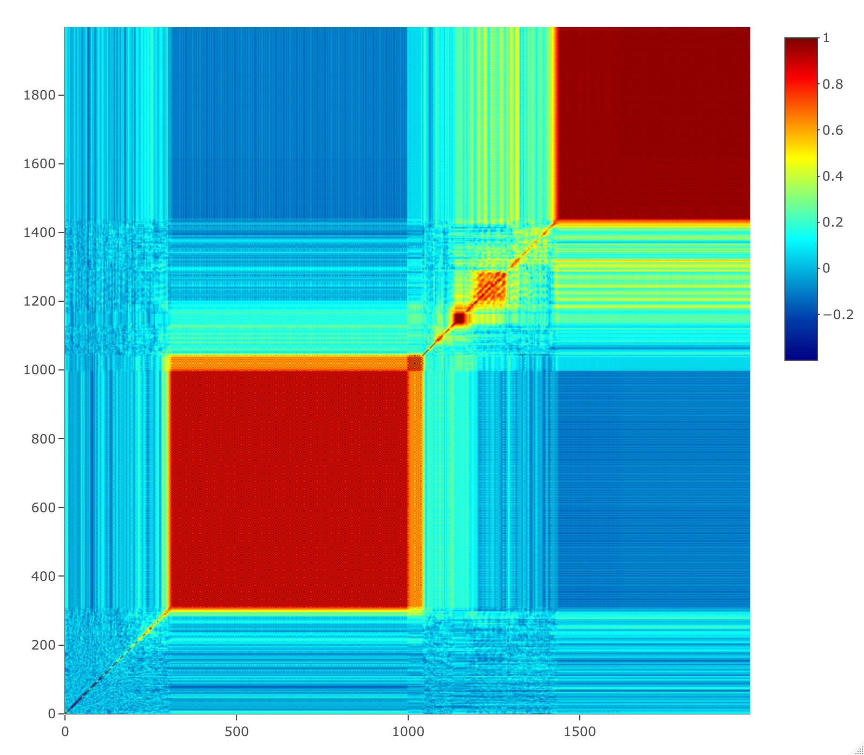
A.
B.
Baseline
C.
D.
With Sensory Noise
E.
F.
With Visual Field Inversion

Slide 5
Baseline
+Sensory Noise
+Visual Field Inversion
Learning Turned Off
A.
B.
C.
VF INVERSION

